Slide 1
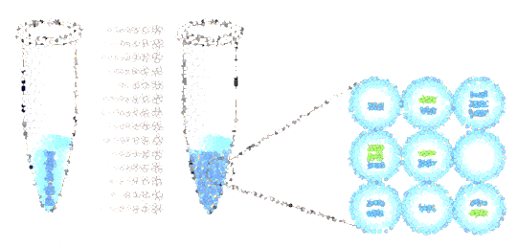
ddPCR Instrument
Development
Stephanie Booth

Slide 2
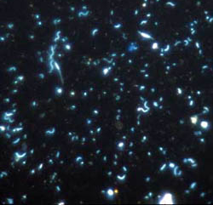
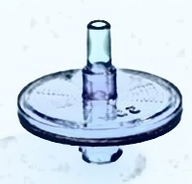
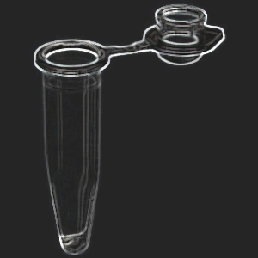
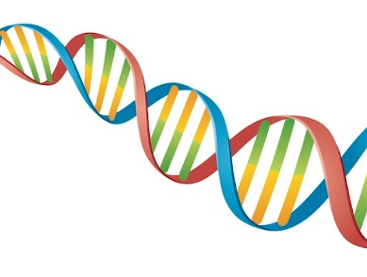
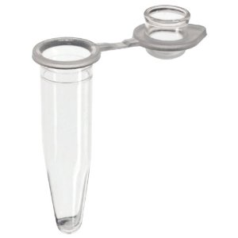
Sample Collection and Processing
Water Sample
Filter
Polymerase enzyme
Fluorophore/Quencher Probe
Lysate
Nucleic Acids
Master Mix
Extraction Kit
Water
Pure DNA or RNA
Pure DNA or RNA
ddPCR volume injected into instrument

Slide 3
Emulsion Microfluidics
Independent reaction volumes within a droplet yield greater potential for sample purity, throughput, scalability, efficiency, & accuracy
Notes:
Digital biology involves a few key components. First is to have small reactor volumes which is readily achieved in microfluidic devices. Droplet emulsions are very well suited for this application.
akva-tek.com/images/droplet.jpg
Emulsion pcr to monodisperse droplets/microfluidics nanowell arrays, to high-dynamic range pcr.
Talk more to the who cares aspect throughout the talk. What is PCR, why is it important

Slide 4
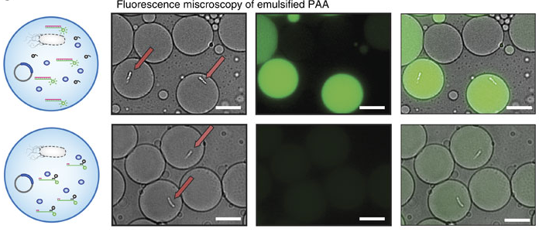
ddPCR

Slide 5
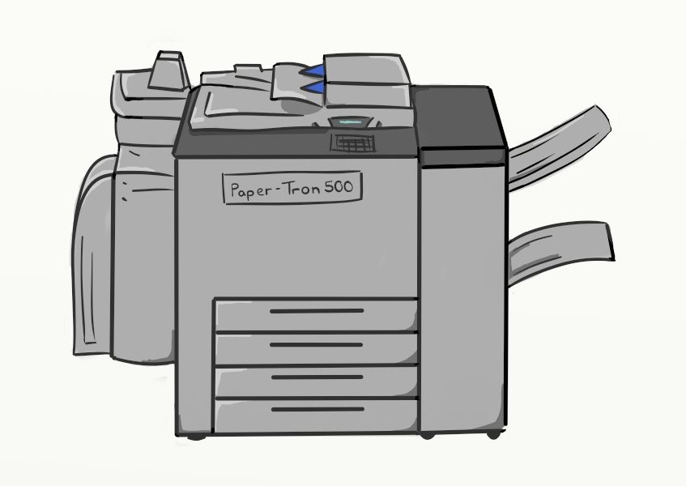
digital droplet Polymerase Chain Reaction
1
?
The ‘original’ copy placed on the glass which is the DNA sample just extracted
The ‘copy’ made will have released fluorophores & treated as a 1 if the DNA is a match
Primer/Probe
Water
ddPCR-Tron 500
The ‘copy’ made will be blank & treated as a 0 if the DNA is NOT a match
0
Master Mix
Notes:
Primer/Probe: This is a combination of nucleic acid templates of the target DNA & fluorophore/quencher pairs that attach to templates & will be separated by polymerase if the template & sample DNA are a match, creating more fluorescence with greater matched DNA concentration
Master Mix: This is a reagent solution with enzymes (polymerase being the one we care most about here), dye(s), buffer(s), & surfactant(s) specifically designed to work together & with a primer/probe set for a particular reaction type

Slide 6
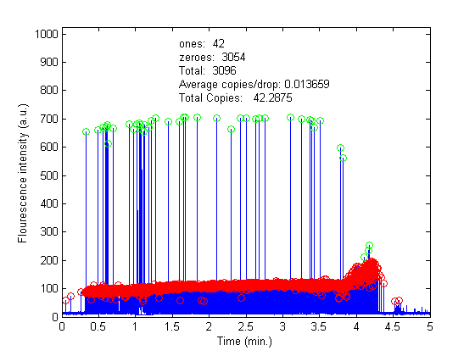
1x dilution (1µL Santa Cruz Wharf sample in 5µL Reaction)
Data Output
10x dilution (0.1µL Santa Cruz Wharf sample in 5µL Reaction)

Slide 7
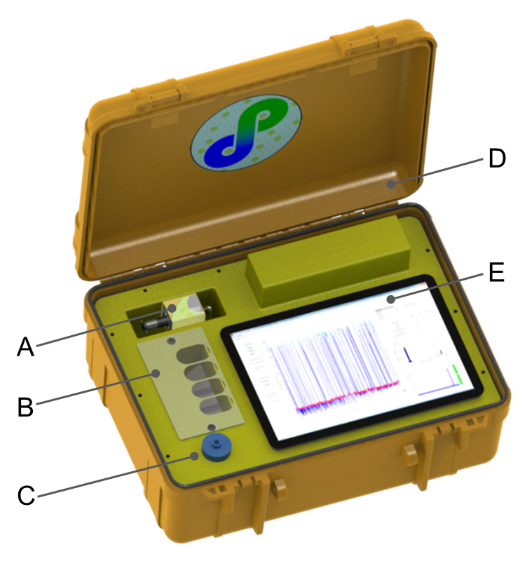
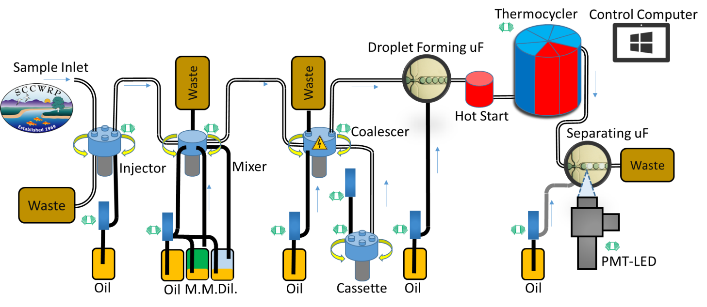
Portable Biological Source Tracking Instrument
PROTOTYPE 2-B
PROCESS FLOW DIAGRAM
A - Extensible to fully-autonomous system
w/ Multi-Primer Cassette
B - Rapid Reagent Reload Dock
View Ports for Reagents
C - Self-sealing needle valve
for repeated sample injection
D - Water tight instrument case
16.9” L x 9.9” W x 6.5” D
E - Touchscreen Tablet PC
Custom MATLAB®-based Interface

Slide 8
Portable Biological Source Tracking Instrument
CRITICAL FEATURES
Continuous On-Site Detection of Target Bacteria and Viruses (DNA, RNA, Proteins and Metabolites) with a single instrument.
Extensible Biological Target List
Low-Power Miniaturized Robust Device for Portable and Remote Deployment
Environmentally Stable Reagents for Extended Operation with No Refrigeration
Background Independent Analyses for Single-Molecule Detection and Titer Measurement
Identified markets in global security, health, safety and environmental science
Application for mass transit, public spaces, hospitals, schools, water quality monitoring, food production, and combat theater

Slide 9
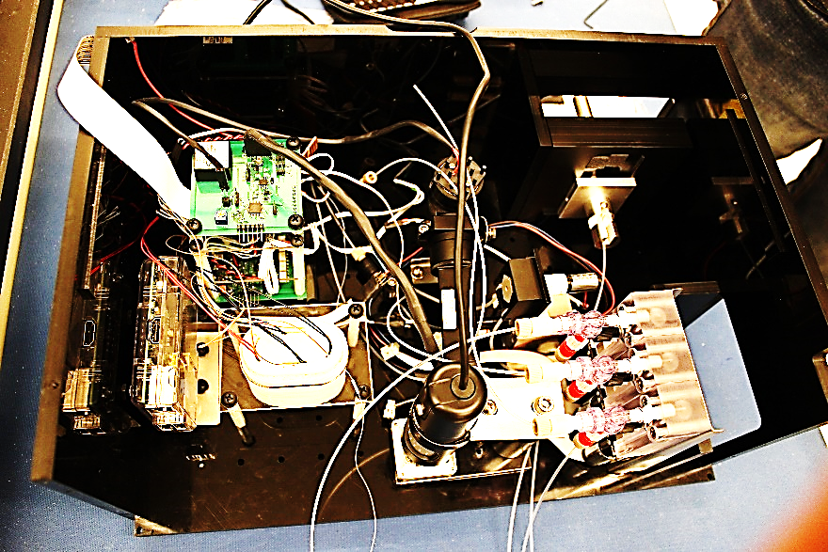
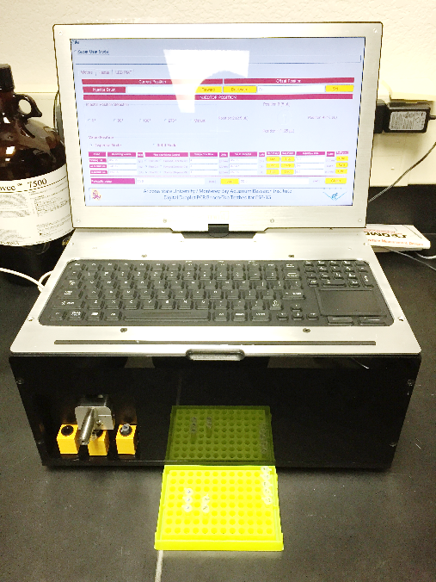
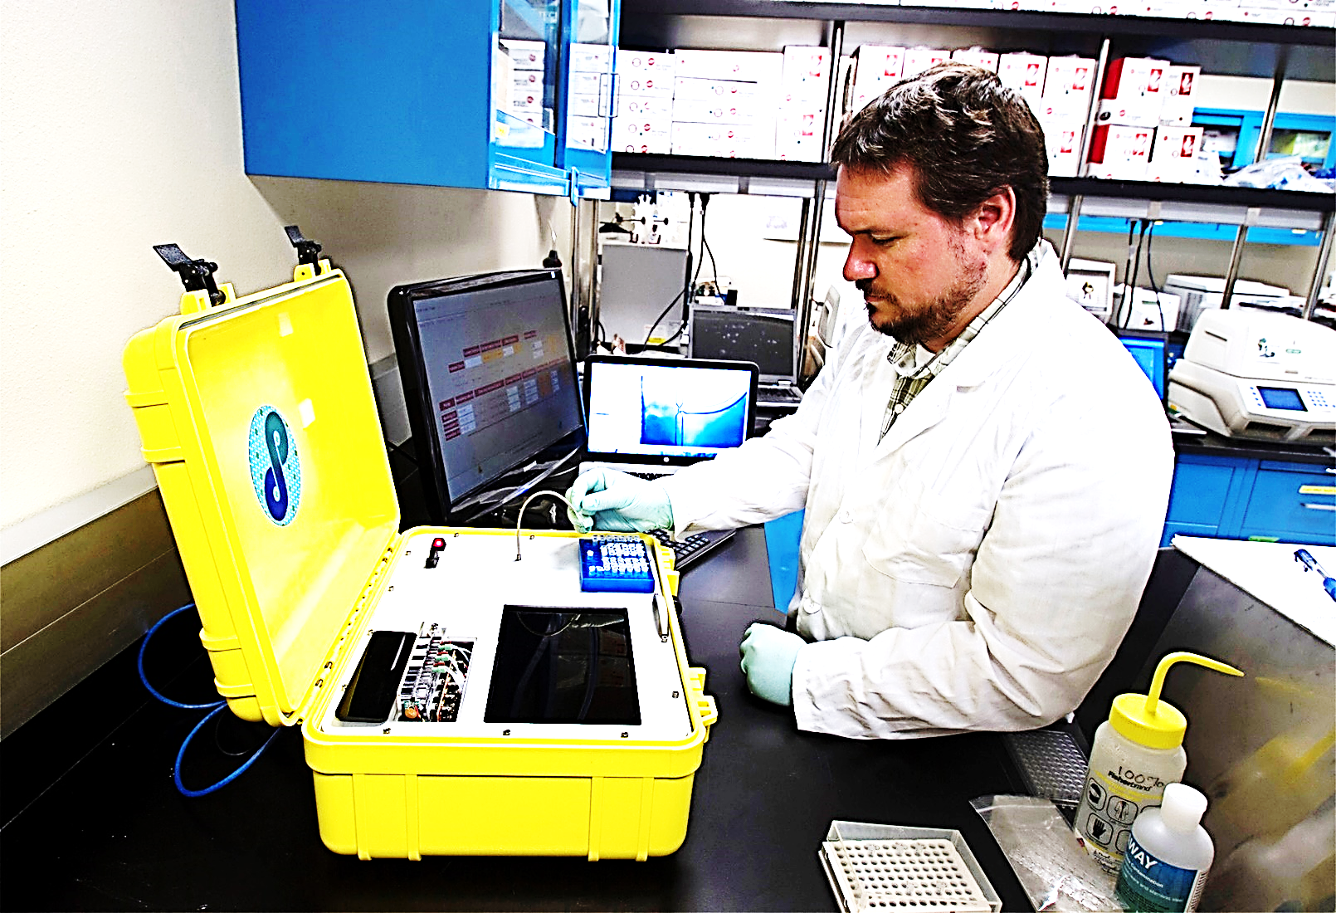
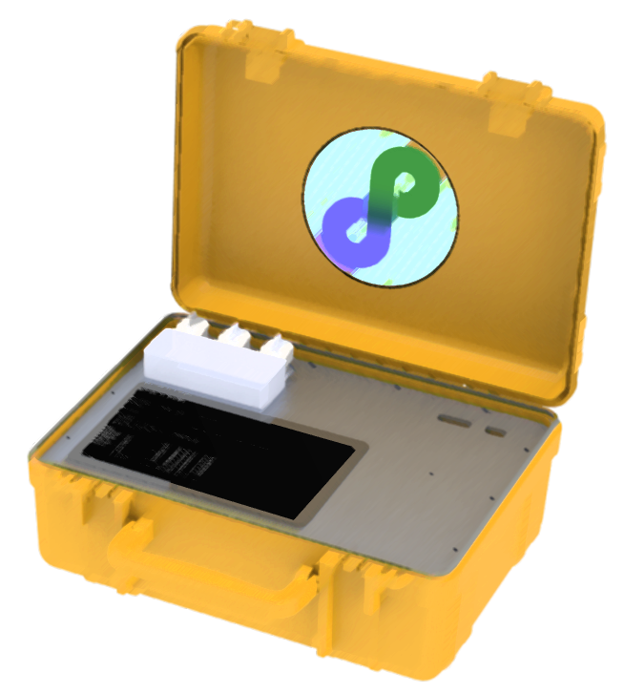
Benchtop ddPCR
April ddPCR instrument
Internal View
Computer Model
In lab use

Slide 10
References and Mentors
Youngbull, A. C., Hatch,A. C., Ray, T., Lintecum, K.L. (2013, December). Presentations and data for continuous flow ddPCR device using multi-channel fluorescence excitation and detection. Presentations and data presented on a continual basis from 2013 to present.
Larsen, A.C., Hatch, A.C., Dunn, M., Youngbull, A. C., Chaput, J.C., Sau, S.P.(2016, April). A General Strategy for Expanding Polymerase Function by Droplet Microfluidics. Nature Communications 7,Article number: 11235 doi:10.1038/ncomms11235.
Bio-Rad. Introduction to Digital PRC. (updated 2016). Retrieved from http://www.bio-rad.com/en-us/applications-technologies/introduction-digital-pcr
SCCWRP. ‘SCCWRP to begin testing suitcase-sized ddPCR instrument.’ (updated 2015, August 19). Retrieved from http://sccwrp.org/homepage/news/15-08-19/SCCWRP_to_begin_testing_suitcase-sized_ddPCR_instrument.aspx
Pen name ‘Roaming_thunder@yahoo.com.’ Um a Photocopier? (updated 2013, July 10). Retrieved from https://roamindoodles.wordpress.com/2013/07/10/um-a-photocopier/

